Slide 1
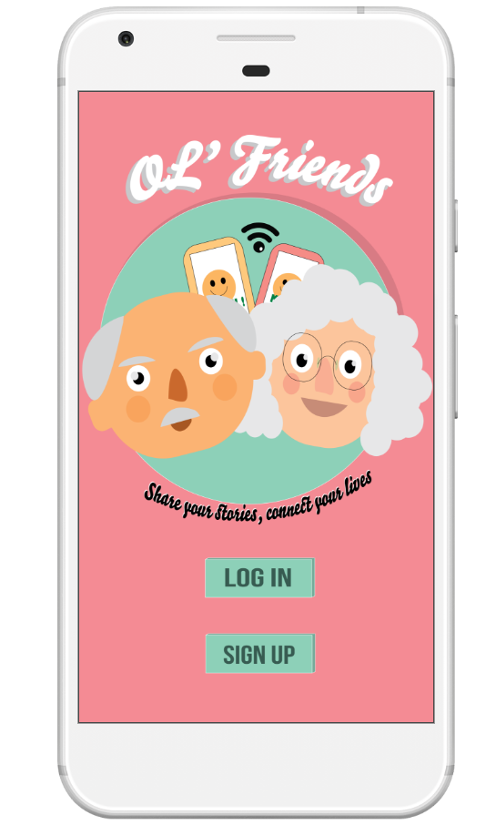
Ol’ Friends
-Share your stories, connect your lives

Slide 2
The NOT list
IN Scope
Login
Messaging - allows user to message their friends
Content Posting - allows user to post things
Commenting features - allows user to comment on friend’s post
Simple interface (Bigger Fonts), Easier Navigation (Navigation Bar) and Autofill Email
News - allows user to view latest news
Help feature - user is able to view help on how to use the app
Language Change (Flexibility)
OUT Scope
Voice Help
Friend Suggestion
Ban system + Status feature
Reminder (Notifications)
Broadcasting of Events (Based on similar interests)
Notes:
IN Scope
Simple interface (Bigger Fonts), Easier Navigation (Navigation Bar) and Autofill Password
Messaging + Content Posting and Commenting features
Onboardingscreen app tutorial
News
Broadcasting of Events (Based on similar interests)
Out Scope
Voice Help
Friend Suggestion
Ban system + Status feature
Reminder (Notifications)
Language Change (Flexibility)

Slide 3
Improvements made since Sprint 1
Help Feature has been implemented
News Feature has been implemented
Bilingual (Chinese & English) Feature has been implemented.
Improvement of UI
Profile picture has been implemented
Comment and Like posts

Slide 4
Rai
Design and Research

Slide 5




Slide 6
How to make the app elder friendly?

Slide 7
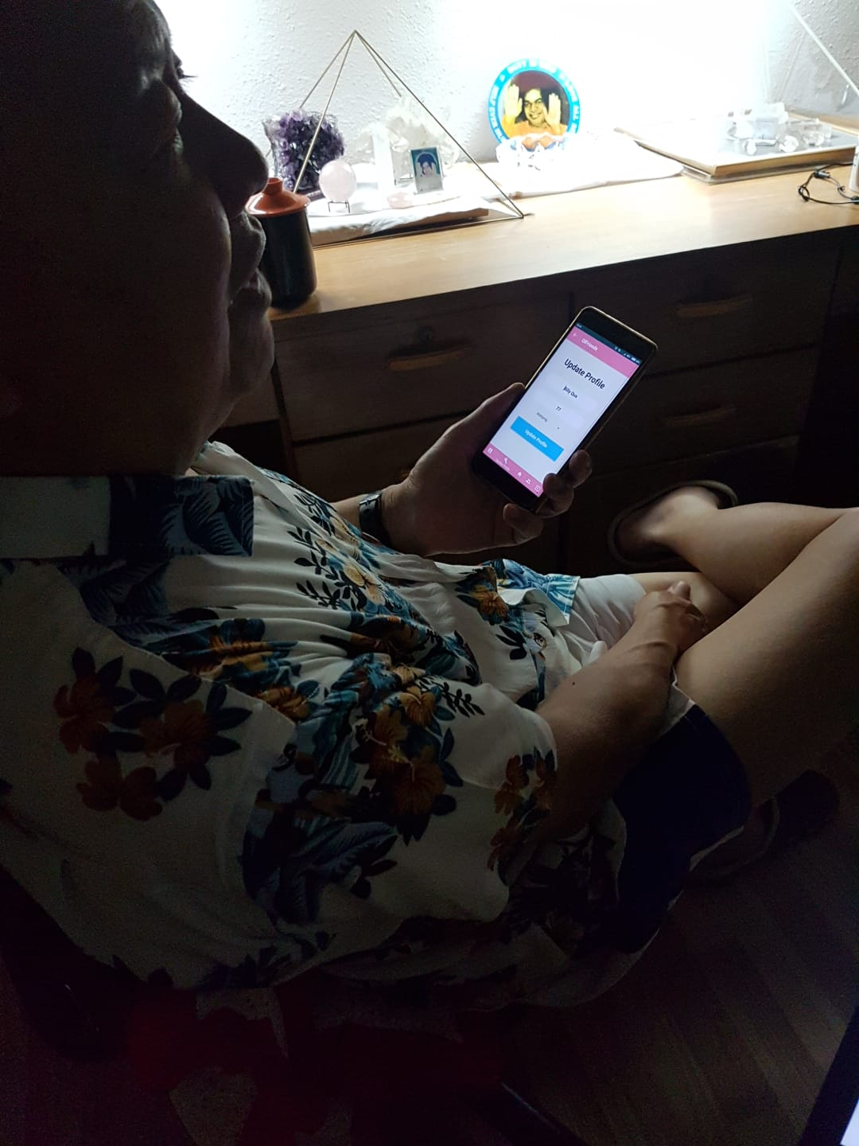
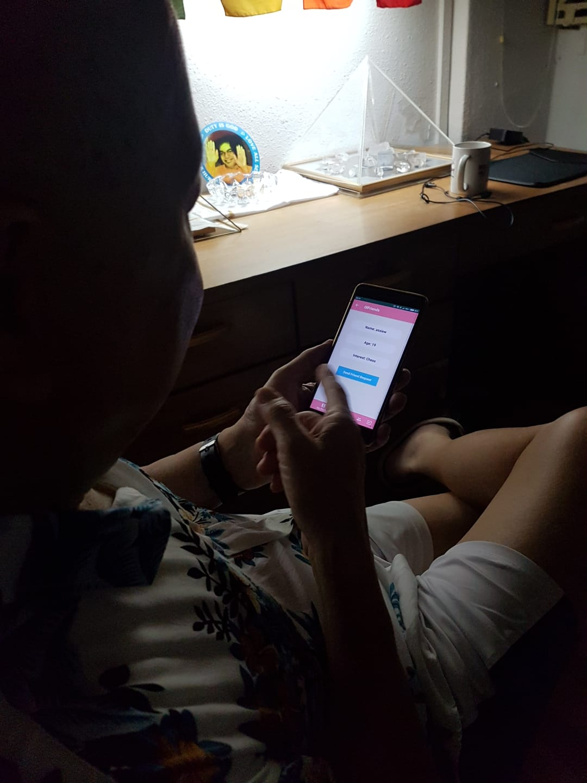

Slide 8
Colour
Font
Navigation and
Layout

Slide 9


Slide 10
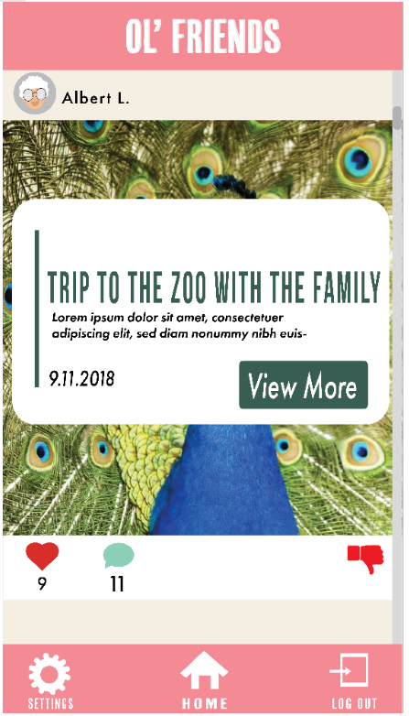


Slide 11
Yu Chyi
Research

Slide 12


Slide 13
Comparison with other similar apps
 | Friend search | Posting content | Message | News | Setting | Help
Facebook | ✅ | ✅ | ✅ | ❌ | ✅ | ✅
Stitch (web) | ❌ | ✅ | ✅ | ❌ | ✅ | ✅
Instagram | ✅ | ✅ | ✅ | ❌ | ✅ | ✅
Ol’Friends | ✅ | ✅ | ✅ | ✅ | ✅ | ✅

Slide 14
Why news feature?

Slide 15

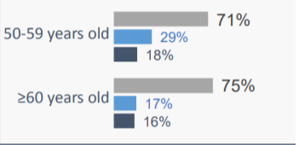
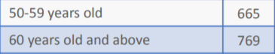
According to interview done by NLB
Number of surveyee:

Slide 16
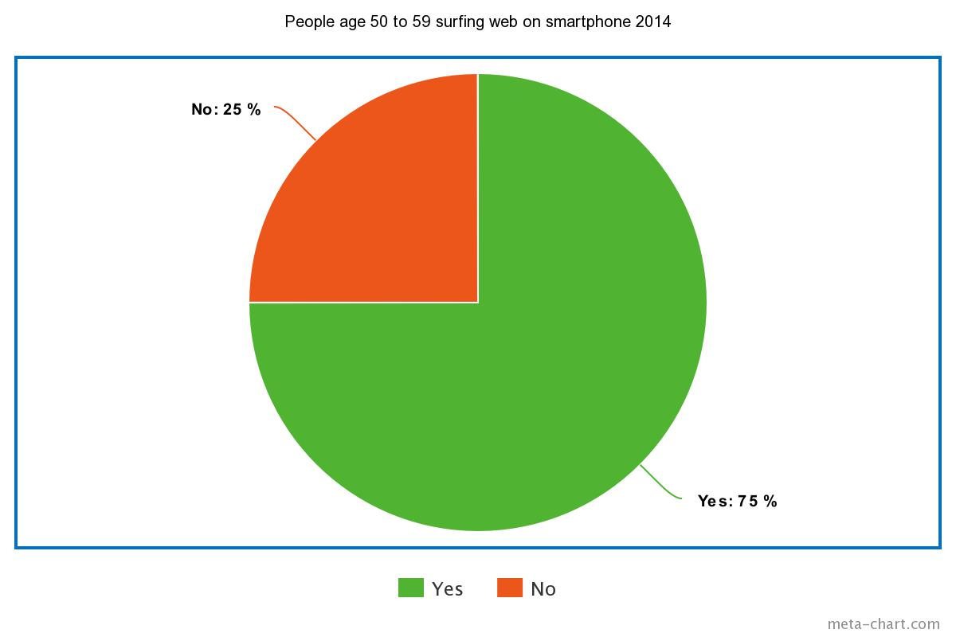

Slide 17
Got positive feedback on news feature

Slide 18
Programmers

